Slide 1
CS 513
Topic 2 : Investigate the Misalignment between Point Cloud and Perspective Image
Preethi Krishnamoorthy Ramesh Kumar
Akash Reddy Gundlapalli
Barani Kumar Kalangal Ramasamy Soundararajan

Slide 2
Agenda
Goal
What is Point Cloud ?
Summary
Provided Resources
Methodology
Output & Analysis
Resources

Slide 3
Goal
In this project, we are going to investigate the misalignment between camera and Point Cloud

Slide 4
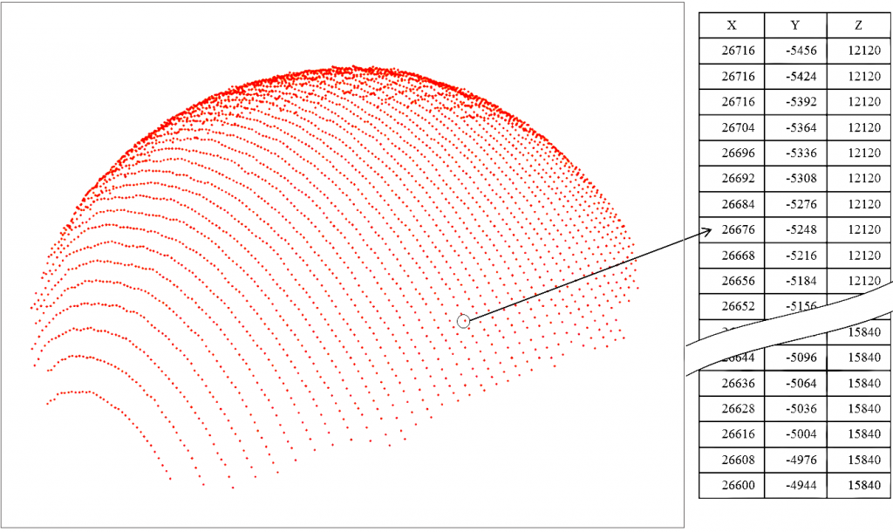
What is point cloud ?
Point clouds are considered as a way of collating a large number of single spatial measurements into a dataset that can then represent a whole.
In simple terms , a point is data point defined by (X,Y,Z) in an arbitrary 3D coordinate system and a set of these points are called as point clouds.
Point clouds are most commonly generated using 3D laser scanners and LiDAR (light detection and ranging) technology.

Slide 5
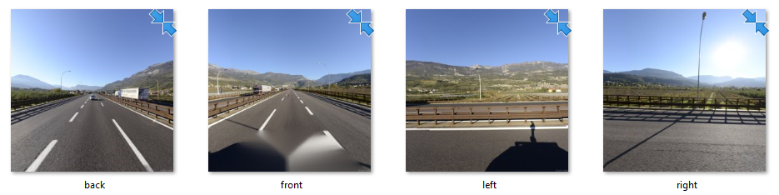
Provided Resources
Coordination_transformations.pptx
A point cloud file (final_project_point_cloud.fuse)
Original images
Camera configuration file(camera.config)

Slide 6
Process overview
Step 1 : The given data file will be processed to obtain the Latitude Longitude Altitude data(LLA) into Earth Centered Earth Fixed(ECEF) using coordinate transformations mentioned in the coordinate Tranformations.pptx.
Step 2: The obtained ECEF will be converted to East, North, Up (ENU) with the help of the coordinate transformations.
Step 3: The obtained ENU will be converted to camera coordinates and then converted it to image coordinates
Step 4: Finally , the misalignment angle(ϴ) between the point cloud image and the given image will be measured using Brute Force technique

Slide 7
Methodology
To perform coordinate transformations ,
Input : final_project_point_cloud.fuse
Process : Input → LLA → ECEF → ENU → Camera Coordinate → Image Coordinate
Output : Point Cloud
To calculate misalignment ,
We have choose a feature based technique where we will be performing a Brute-Force Matching with ORB descriptors
And to quantify the misalignment , average angle differences between keypoints with closest matches are calculated.

Slide 8
Methodology - Step 1
In this step , we will be performing the conversion of LLA(Latitude Longitude Altitude data) to ECEF(Earth Centered Earth Fixed)
The ECEF Coordinates (X,Y,Z) can be calculated using the formula stated below,
Where Φ = geodetic altitude , λ = longitude , h = altitude , a = equatorial radius , b = polar radius , e = eccentricity , N(Φ) = distance from surface to z-axis along the ellipsoid normal
X=(h+N(Φ)) cos⁡(λ) cos⁡(Φ)
Y=(h+N(Φ)) cos⁡(Φ) sin⁡(λ)
Z=(h+(1-e^2)N(Φ)) sin⁡(Φ)

Slide 9
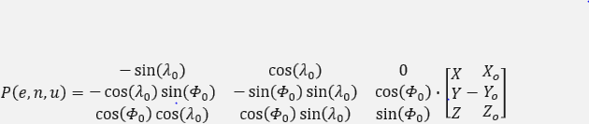
Methodology - Step 2
In this step , we will be converting the ECEF coordinate values obtained from previous step to ENU(East North Up) coordinates.
The ENU coordinates P(e,n,u) can be calculated using the formula stated below ,
Where, P(X,Y,Z) = input location in ECEF , O(X,Y,Z) = Origin location in ECEF , = = geodetic altitude of origin location , = longitude of origin location

Slide 10
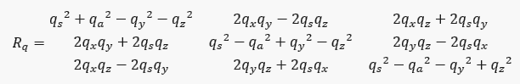
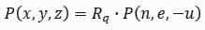
Methodology - Step 3
In this step , The East North Up coordinates will be converted to Camera coordinates
Firstly , The orthogonal matrix Rq will be derived as mentioned below ,
= camera unit quaternion input
Camera coordinates P(X,Y,Z) can be calculated using ,

Slide 11
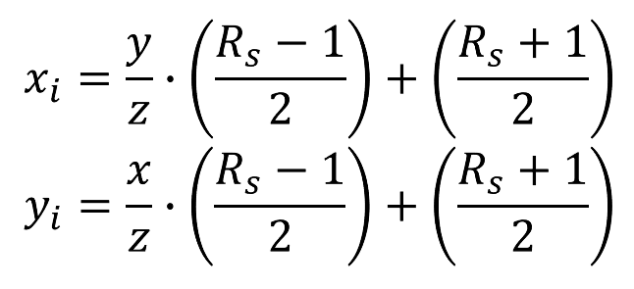
Methodology - Step 4
Here the camera coordinates will be converted to image coordinates
The image coordinate with the help of the formulas,
Using this formula , we will be calculating the image coordinates for left,right,back and front images.

Slide 12

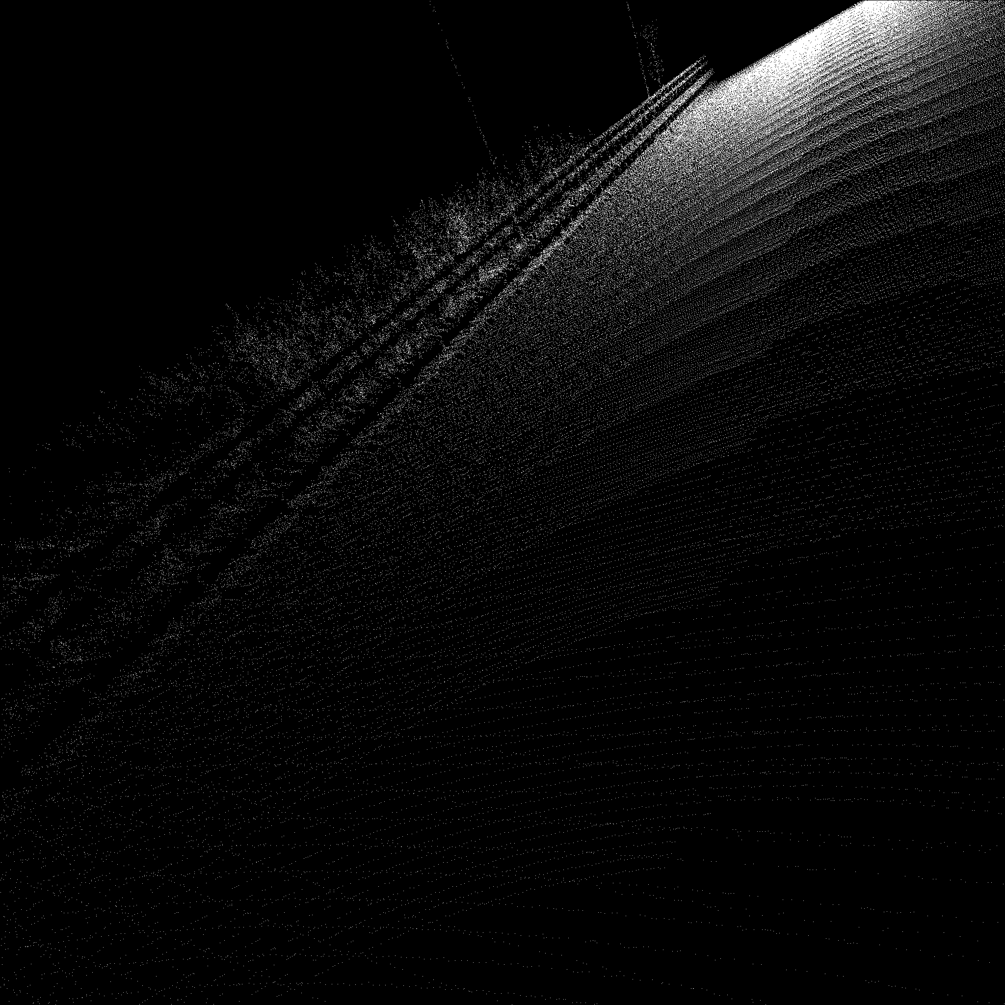
Methodology - Drawing point cloud image
Create a black canvas image (zero value) with the matrix order 2048 x 2048
Now we have the P(Xi,Yi) image coordinates as a result of coordinate transformation
Using this coordinates , now we will be able to change the respective points in matrix with a colour value
After updating all the point from obtained coordinate , the point cloud image will be formed
Update the matrix with the help of coordinates

Slide 13
Methodology - Calculating Misalignment
As mentioned previously , we will using Brute Force Matching with ORB Descriptors to find out the closest matches..
Initially the keypoints and descriptors with ORB
A BFMatcher object with distance measurement cv2.NORM_HAMMING (crossCheck is enabled for better results)
Find the best matches in two images using Matcher.match().
Sort them in ascending order of their distances to find out the closest pair..
Once after finding out the matches , we find the average between the key points of the closest matches to calculate the misalignment angle.

Slide 14
Summary Chart
X=(h+N(Φ)) cos⁡(λ) cos⁡(Φ)
Y=(h+N(Φ)) cos⁡(Φ) sin⁡(λ)
Z=(h+(1-e^2)N(Φ)) sin⁡(Φ)
final_project_data.fuse
Input file
LLA
ECEF
Image Coordinates
Camera Coordinates
ENU
ORB
Misalignment Calculation

Slide 15
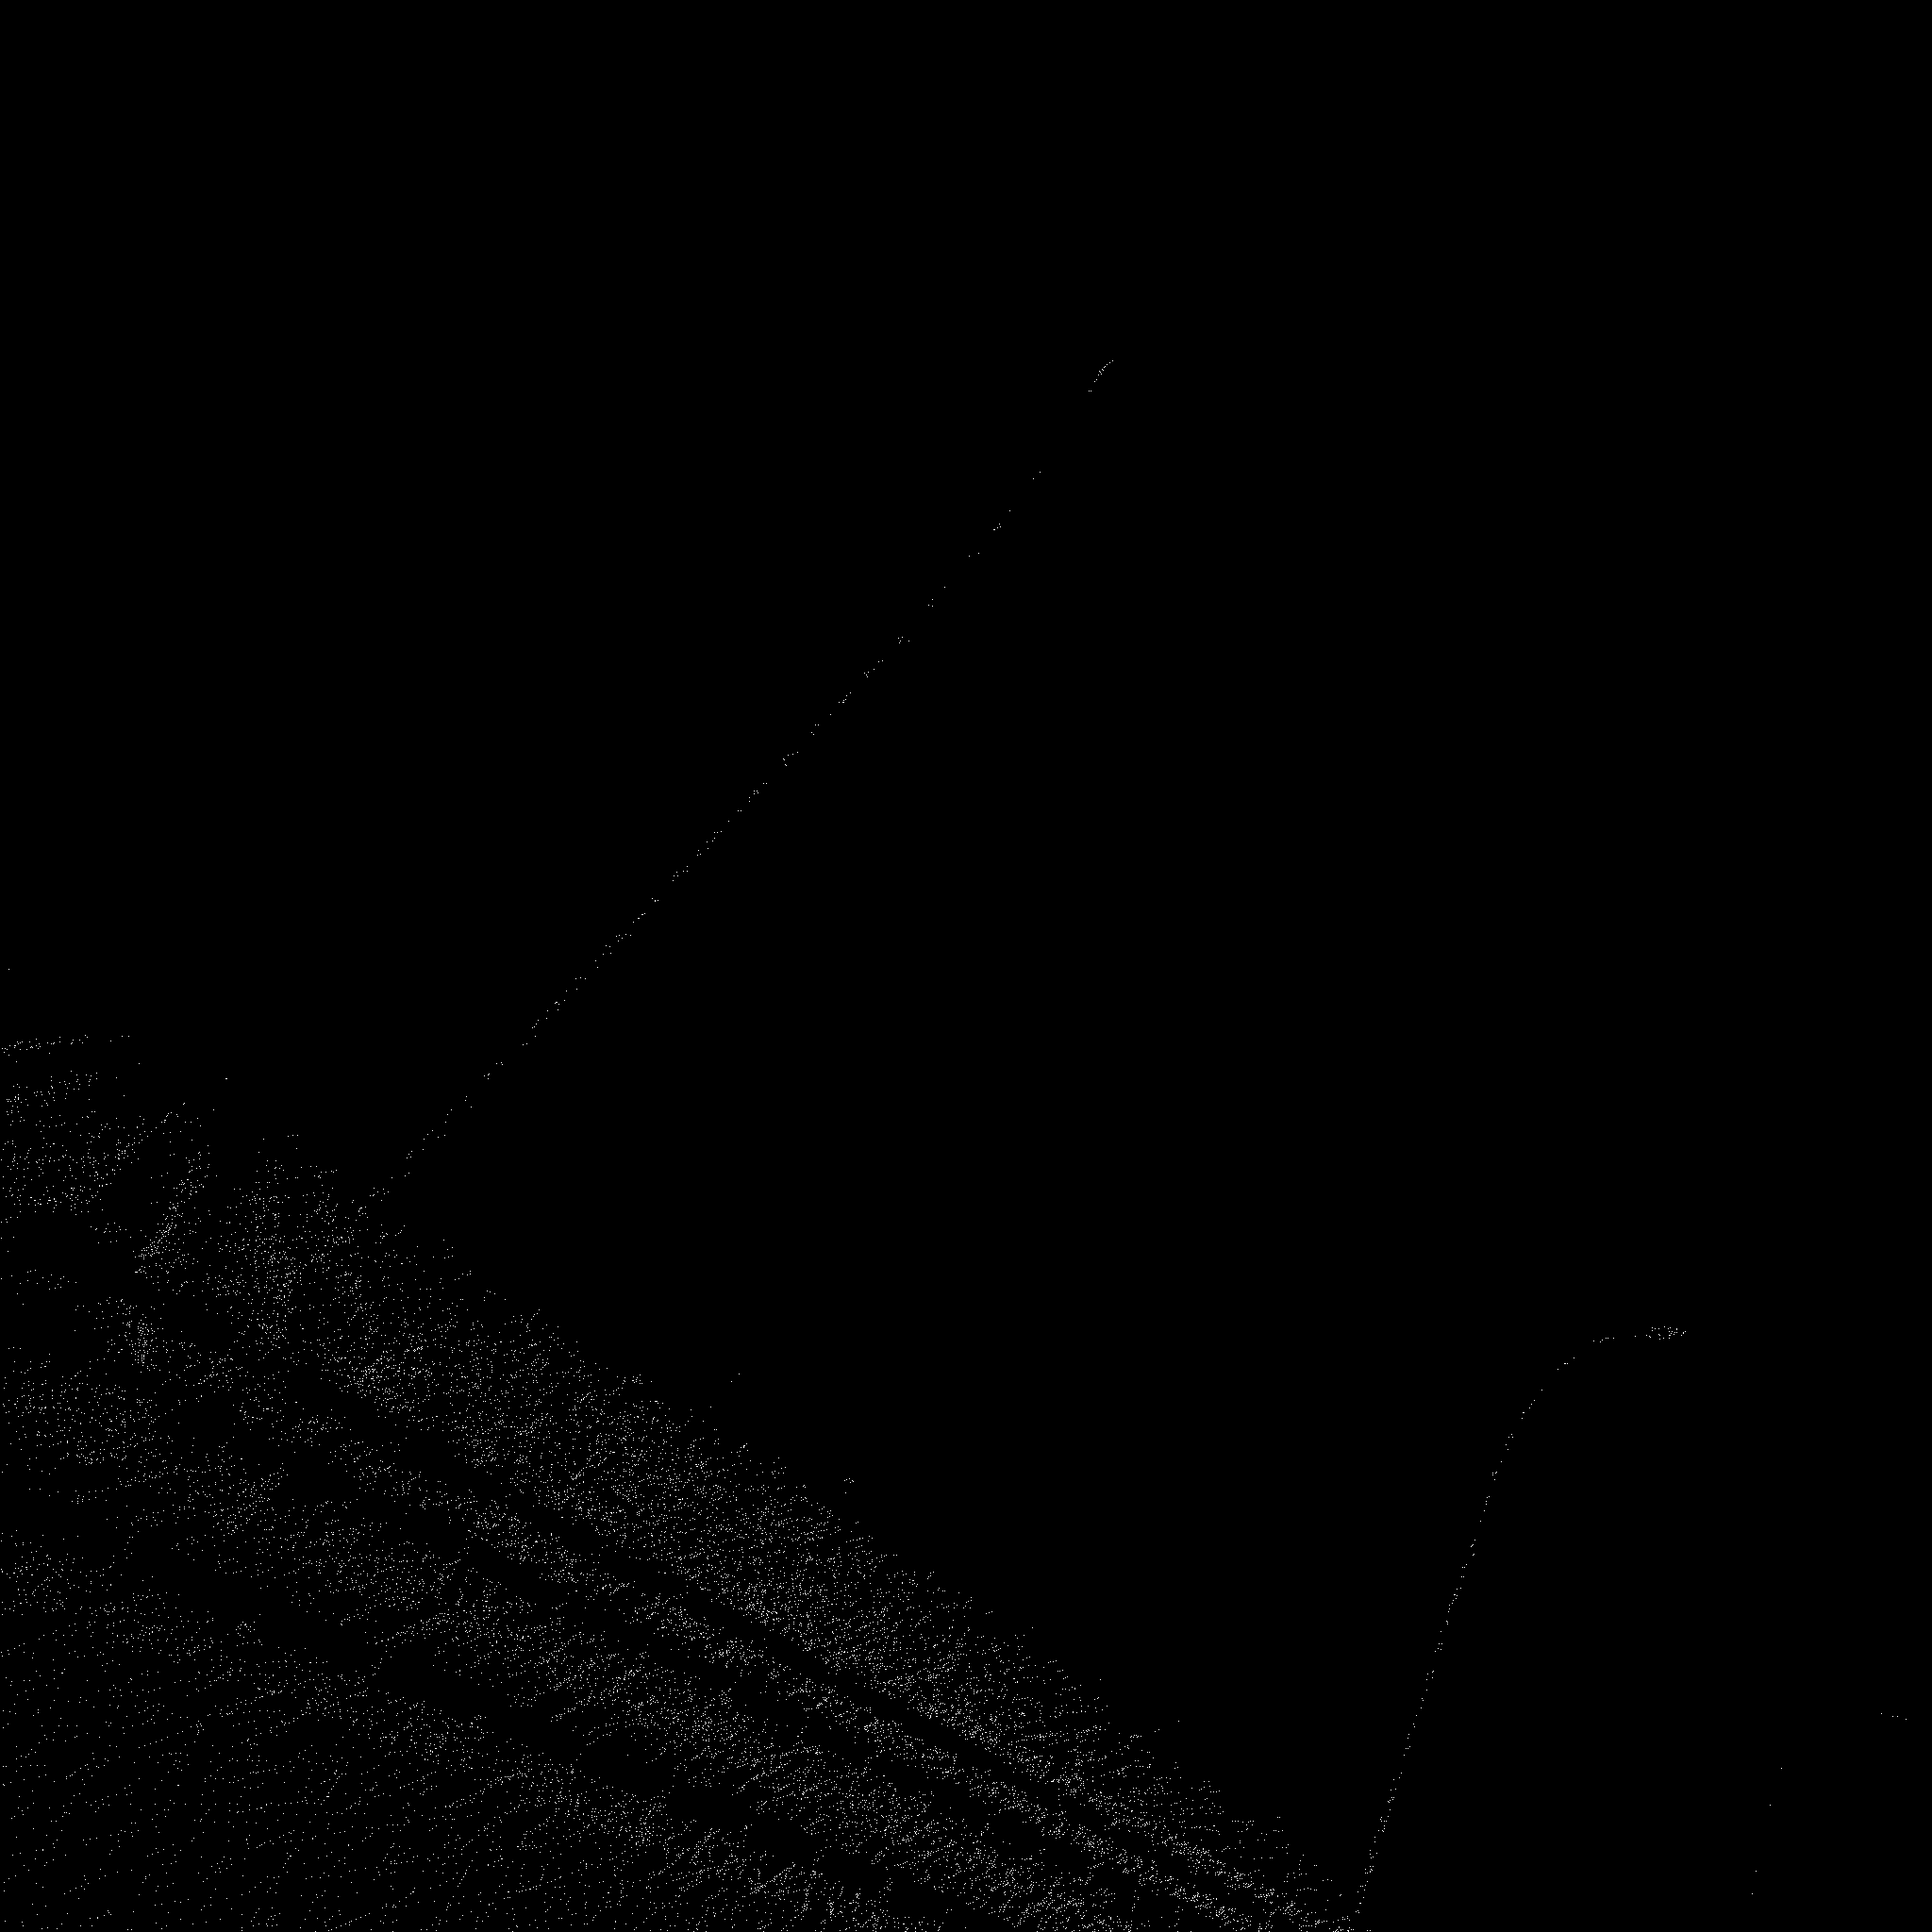
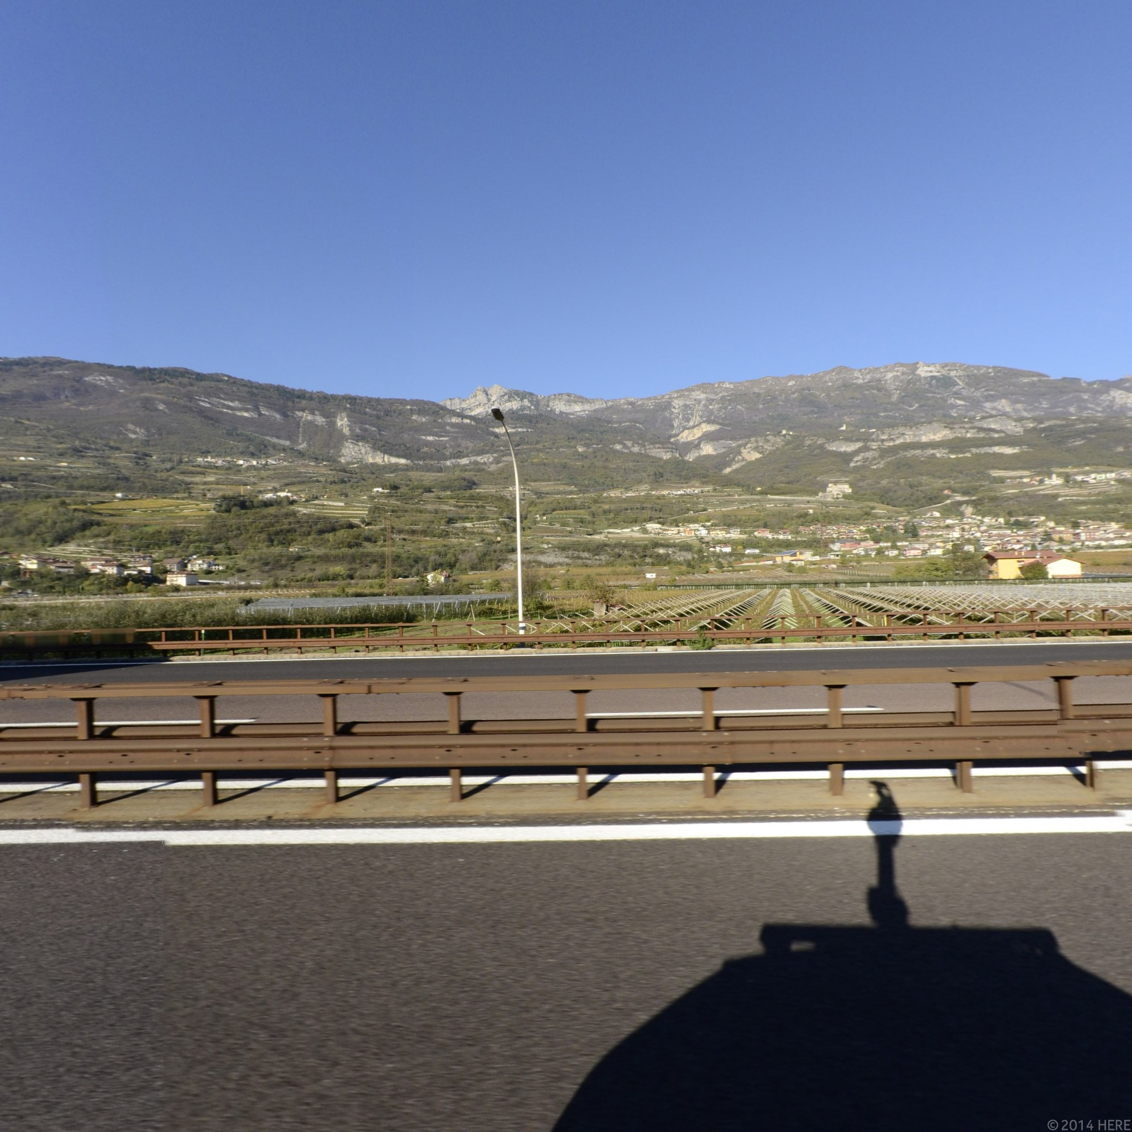
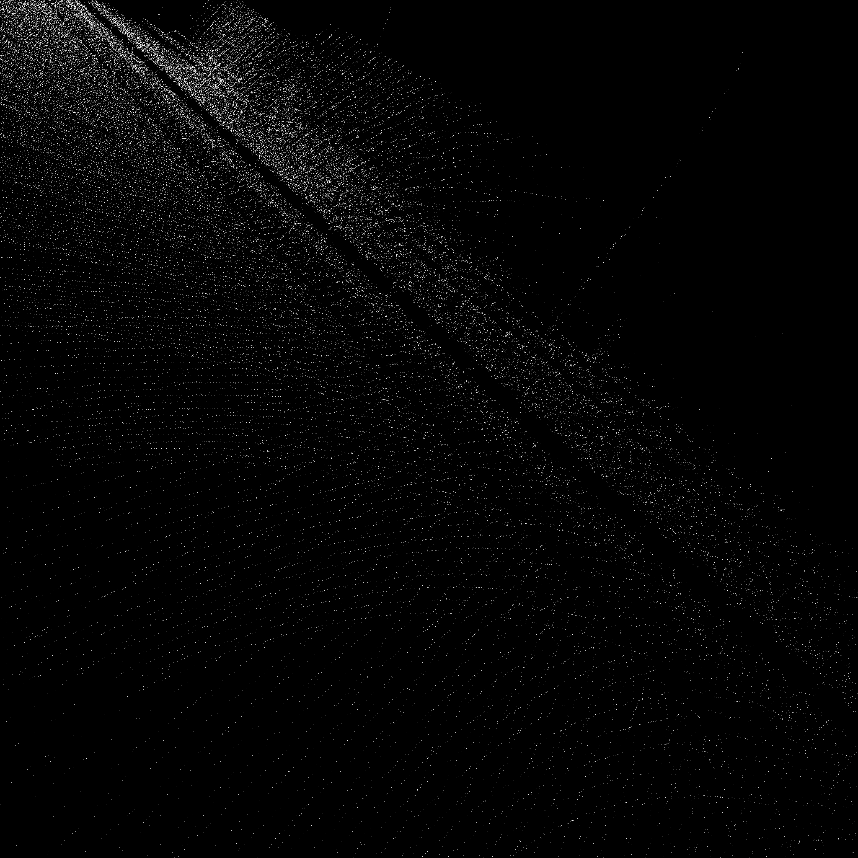
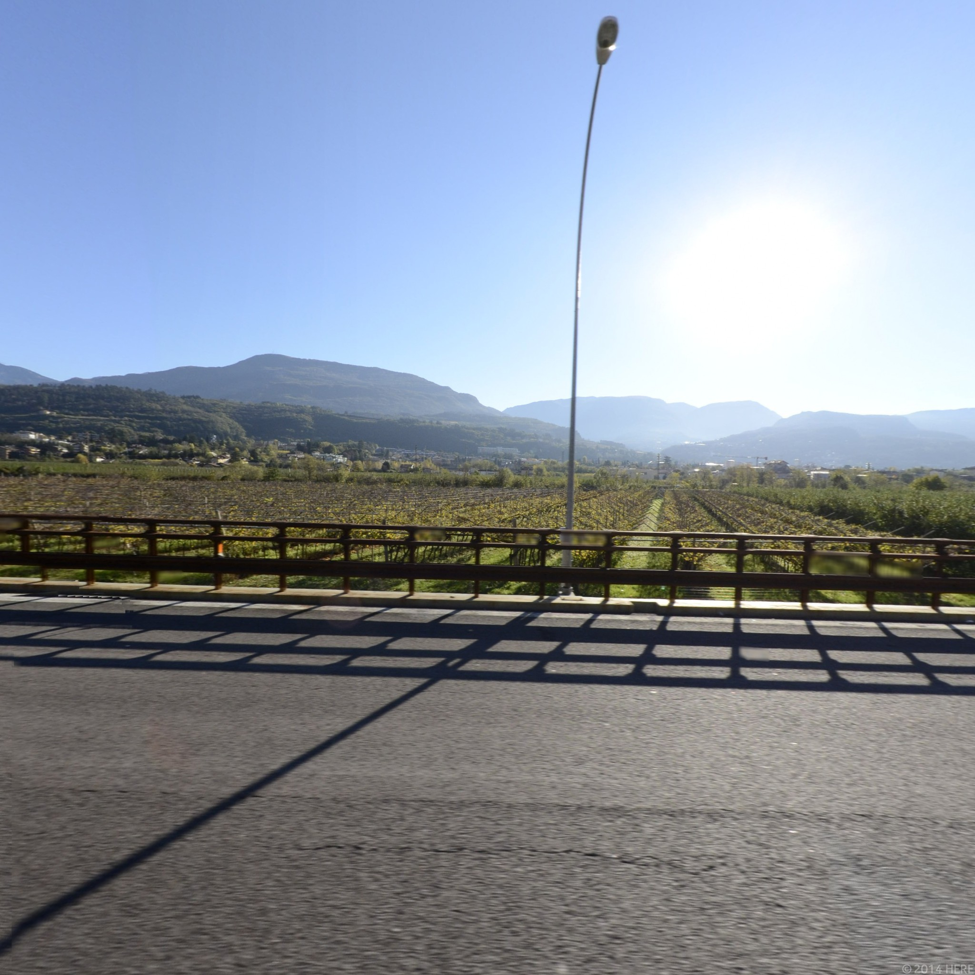
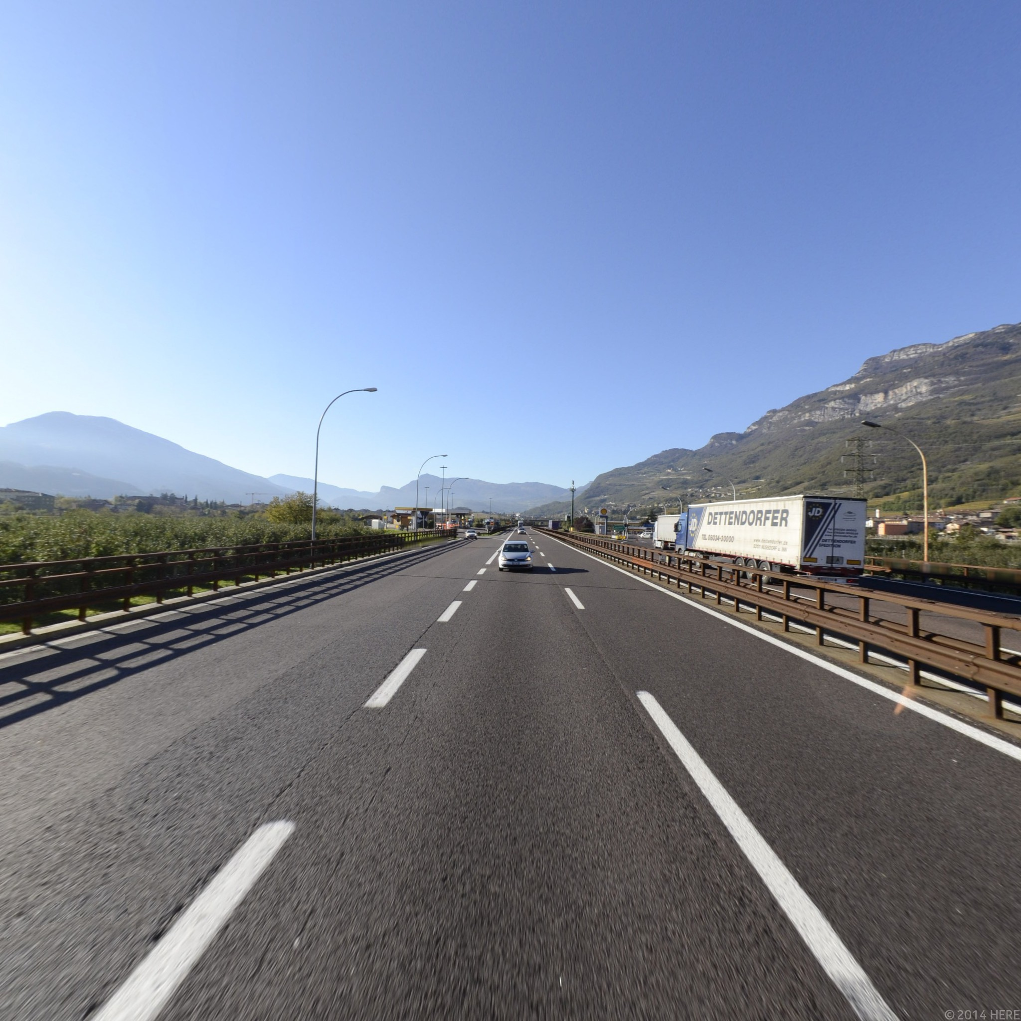
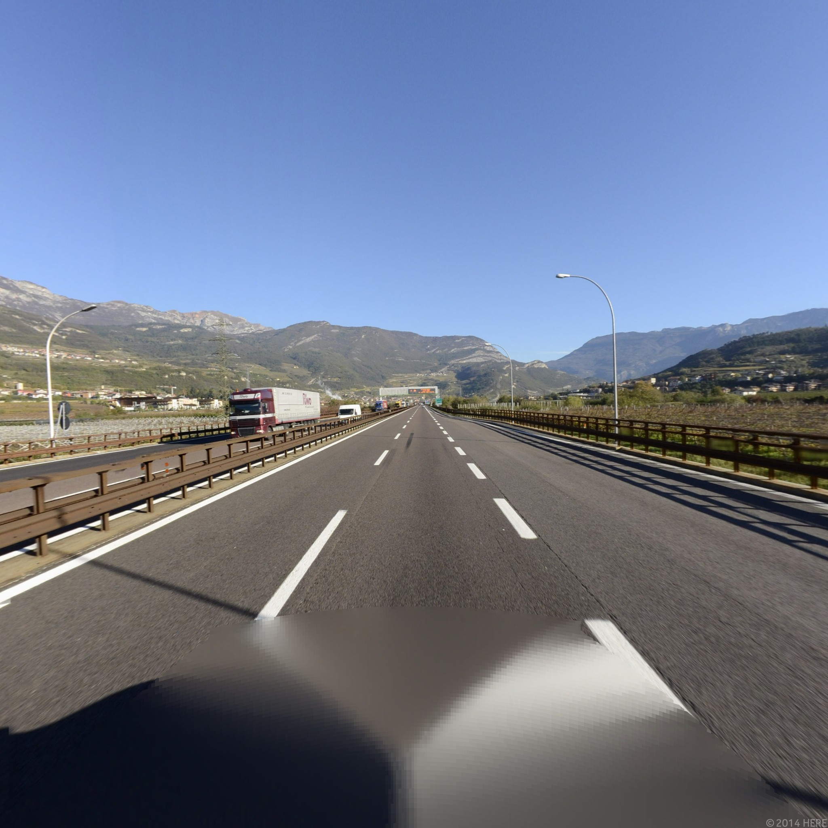
Output & Analysis
Visual Comparison of the obtained point cloud image vs the original image
Left: Right:
Back: Front:

Slide 16
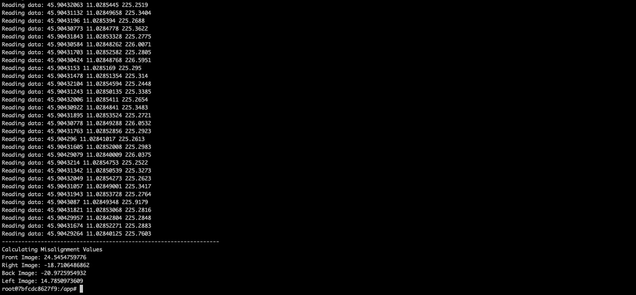
Output & Analysis
The misalignment values are obtained from the code
For a better understanding of the obtained results , we have used meshlab tool to visualise the point cloud images.

Slide 17
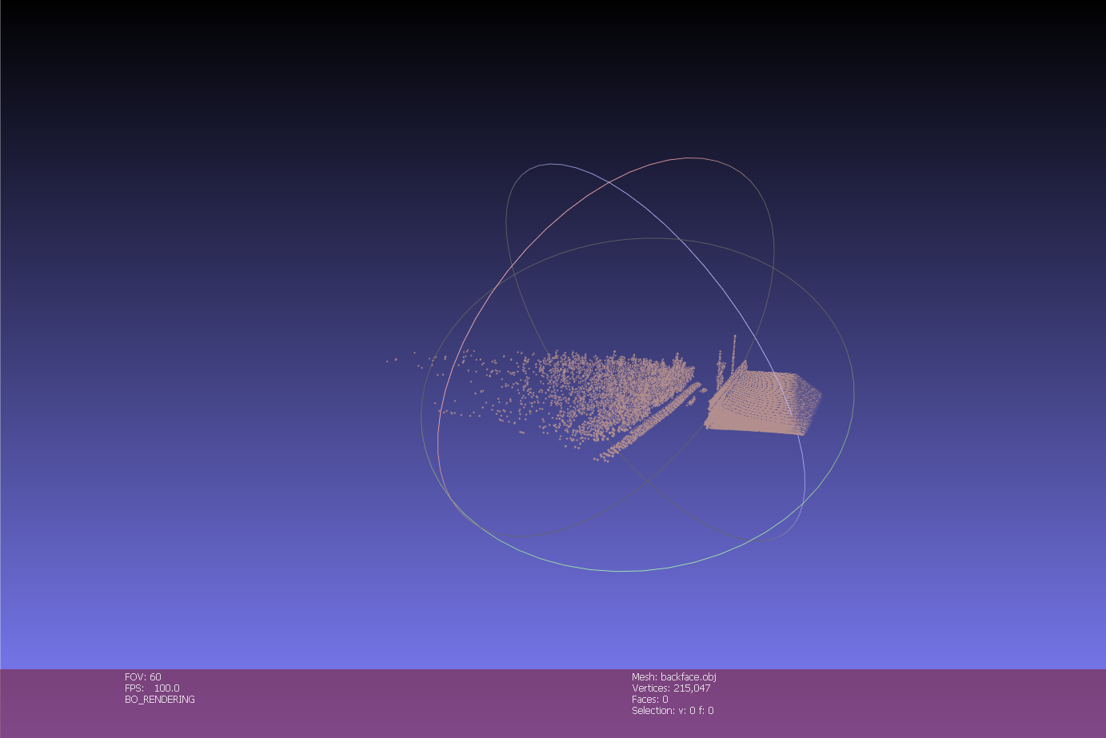
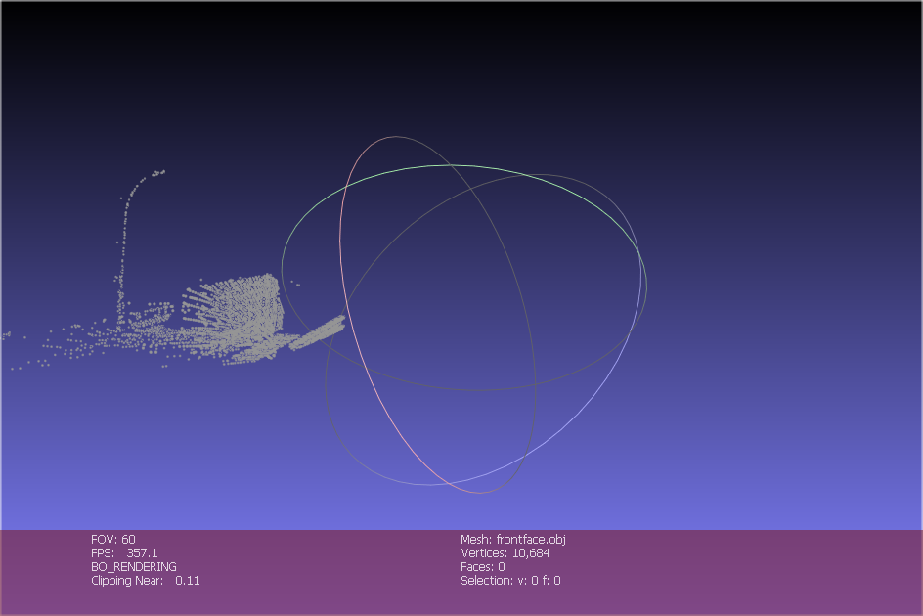
Back face and Front face of the cube

Slide 18
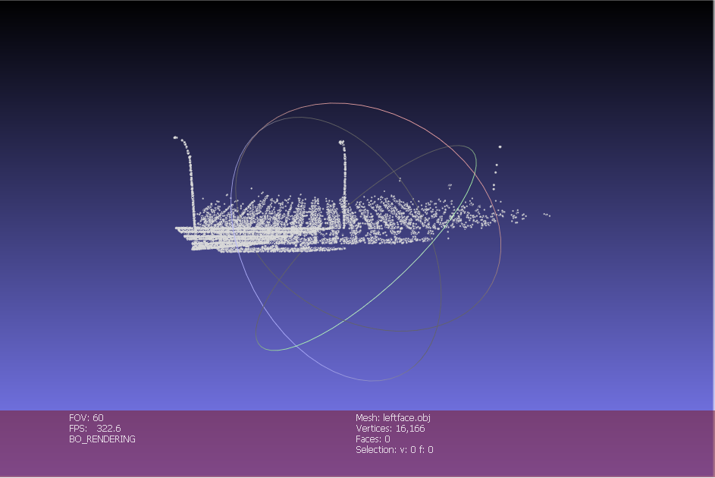
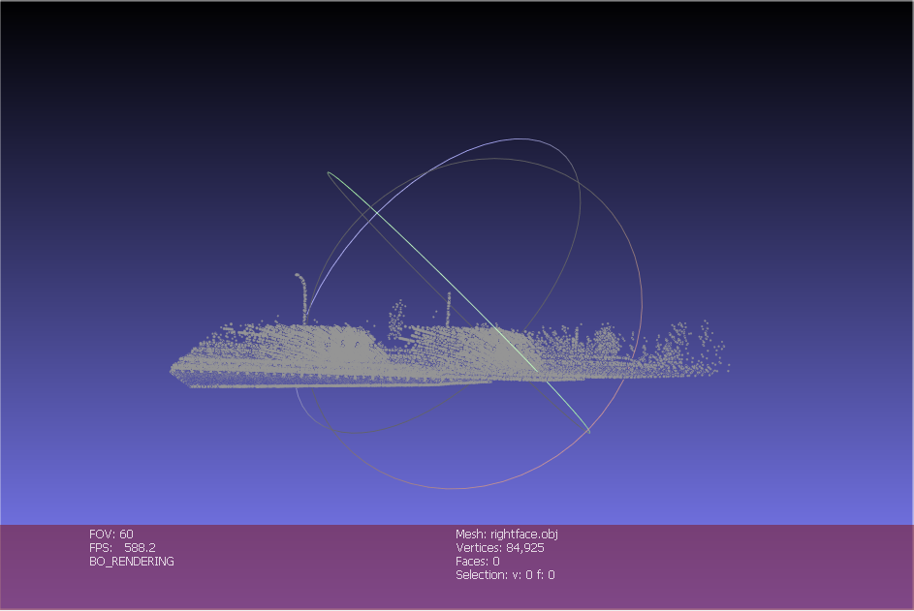
Left face and Right face of the cube

Slide 19
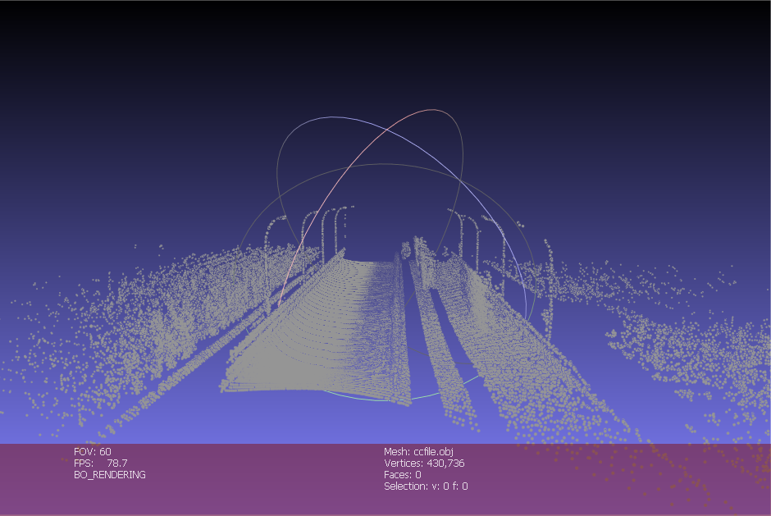
Camera Cube face

Slide 20
Conclusion
From the rendered cube faces , we can see that the obtained field of vision (FOV) is 60 degrees instead of 90 degrees.
Hence we can conclude the experiment stating that there is an approximate inclination of 30 degrees.

Slide 21
Resources
Coordinate_transformations.pptx
“ecef2enu.” Transform geocentric Earth-centered Earth-fixed coordinates to local east-north-up - MATLAB ecef2enu - MathWorks 中国. Accessed April 29, 2020. https://ww2.mathworks.cn/help/map/ref/ecef2enu.html.
“Covert Lat, Lon, Alt to ECEF Cartesian.” Covert lat, lon, alt to ECEF Cartesian - File Exchange - MATLAB Central. Accessed April 29, 2020. https://ww2.mathworks.cn/matlabcentral/fileexchange/7942-covert-lat--lon--alt-to-ecefcartesian.

Slide 22
Thank You

